Slide 1
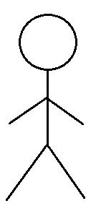
Use Case Diagram
UNITFIT- fitness Application
Use Case Diagram
Module: 01. Home Page
01.01 Create an Account
Online Users
Account Manager
01.02 Sign-in into account
Sponsored Users

Slide 2
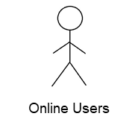

Use Case Diagram
UNITFIT- fitness Application
Use Case Diagram
Module: 02. Workout Plan Schedule Menu
02.01 Selecting a Goal
02.02 Browse the type of workout
02.03 Level of Intensity
Sponsored Users

Slide 3
Use Case Diagram
UNITFIT- fitness Application
Use Case Diagram
Module: 03. Nutrition Program
03.01 Diet Planner
Online Users
0.3.02 Recipes
Nutritional Writer
Sponsored Users

Slide 4
Use Case Diagram
UNITFIT- fitness Application
Use Case Diagram
Module: 04. Dashboard
04.01. Workout statistics
Sponsored Users

Slide 5
Use Case Diagram
UNITFIT- fitness Application
Use Case Diagram
Module: 05. Purchase Bundle
05.01 Freemium
05.02 Paid Subscription
Sponsored Users
Account Management

Slide 6
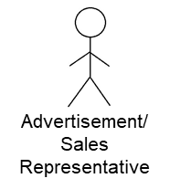
Use Case Diagram
UNITFIT- fitness Application
Use Case Diagram
Module: 06. Sponsored Post and Listings
06.01 Ads and Promo's

Slide 7
Use Case Diagram
UNITFIT- fitness Application
Use Case Diagram
Module: 07. User Account
07.01 Modify General User's Information
07.02 Modify Goal
Online Users
Account Manager
07.03 Add a New Card
07.04 Contact a Customer Support
Sponsored Users
07.05 Reset the password
Trainer
07.06 Delete an Account

